Slide 1

http://datasploit.info | @datasploit

Slide 2
Overview of Tool?
Performs Automated OSINT (Reconnaissance) on Domain / Email / Username.
Fetches information from multiple sources.
Works in passive mode, i.e. not a single packet is sent to the target.
Customized for Pen-testers / Product Security Guys / Cyber Investigators.
Available as command line as well as GUI.

Slide 3
How it works
Python Client
Mongo Db
Django
Celery
RabbitMQ

Slide 5
Components
Python: all the logic.
MongoDB: Storing all files in json dicts.
Django: Web UI
Celery: Handles tasks thrown from UI, sends results back to UI.
RabbitMQ: Used by Celery for message queuing.

Slide 6
Sources
Domain:
WhoIS
DNS Records
PunkSpider
Wappalyzer
Github
Email Harvestor →→
Domain IP History
Pagelinks
Wikileaks
Subdomains
Links from Forums
Passive SSL Scan
ZoomEye
Shodan
Censys
Email:
Work History
Social profiles
Location Information
Slides
Scribd Documents
Related Websites
HaveIBeenPwned
Enumerated Usernames →→
Username:
Git Details
Check username on various sites.
Profile Pics –Output saved in $username directory
Frequent Hashtags
Interaction on Twitter.

Slide 7
Documentation
http://www.datasploit.info
http://datasploit.readthedocs.io/en/latest/
https://upgoingstar.github.io/datasploit/

Slide 8
How it works?
Download from git (git clone or dowload)
git clone https://github.com/upgoingstar/datasploit.git
pip install –r requirements.txt (includes django and celery
Instal MongoDb and RabbitMQ
Config.py holds API keys
domain_xyz.py – running stand alone scriptss.
domainOsint / emailOsint – automated OSINT

Slide 9
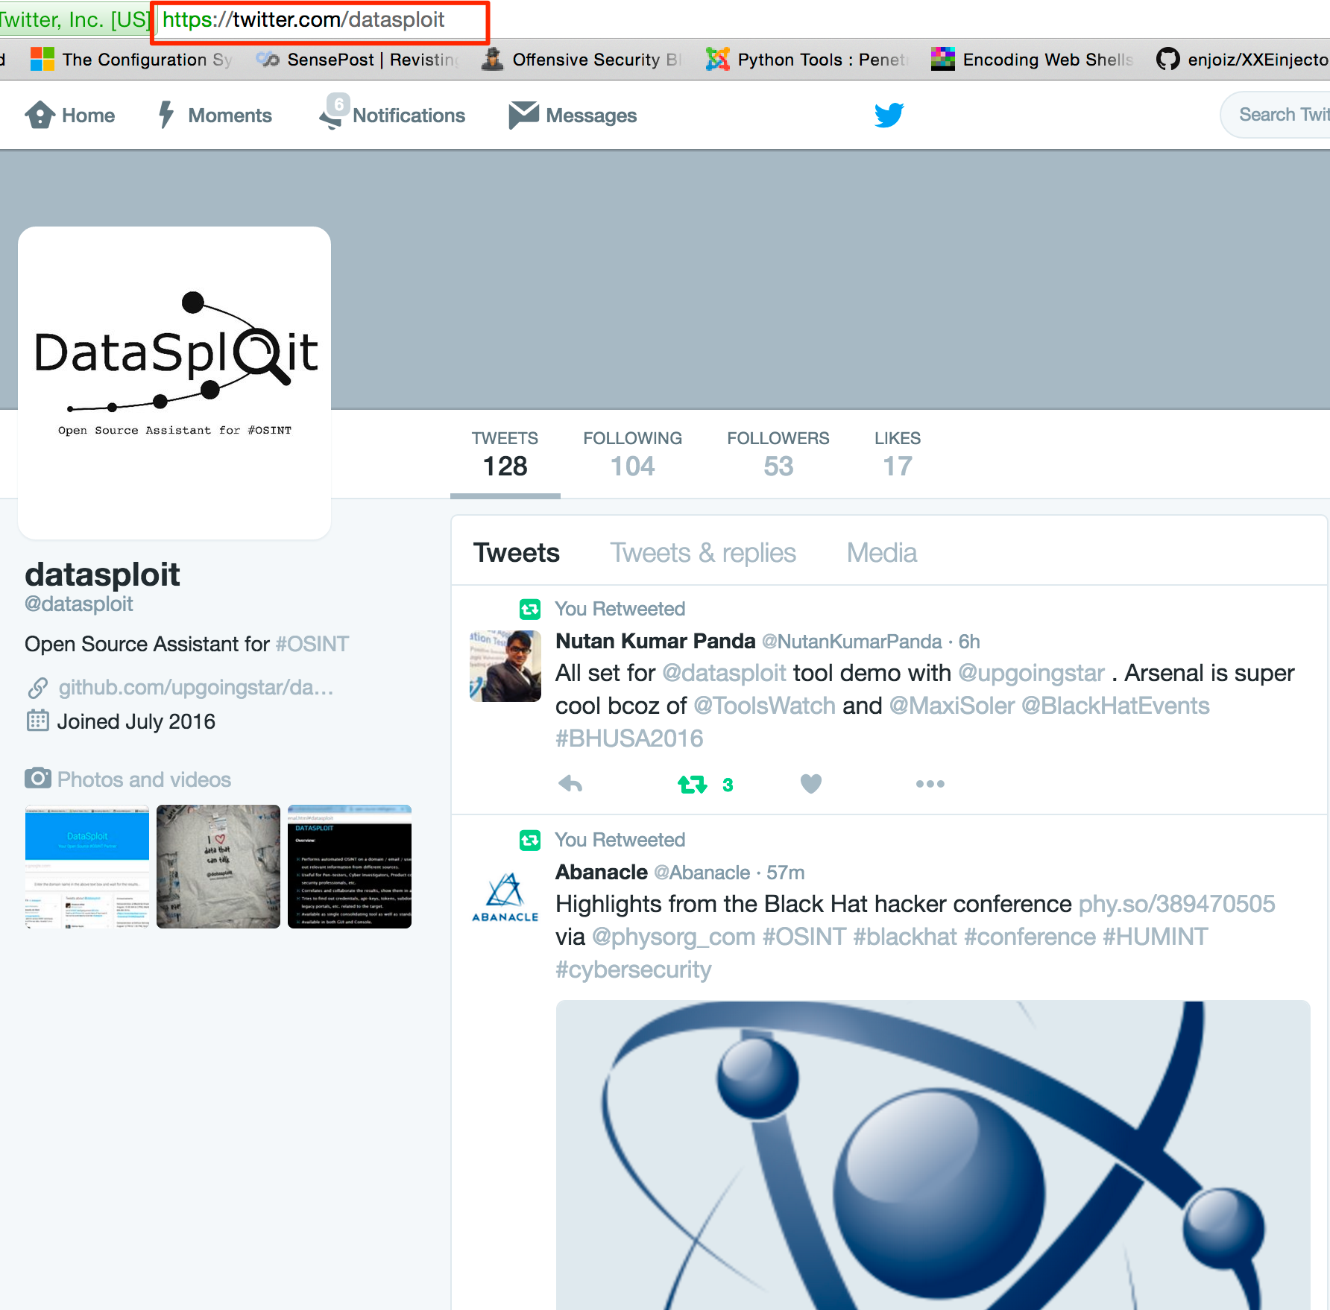
Twitter: @datasploit https://twitter.com/datasploit

Slide 10
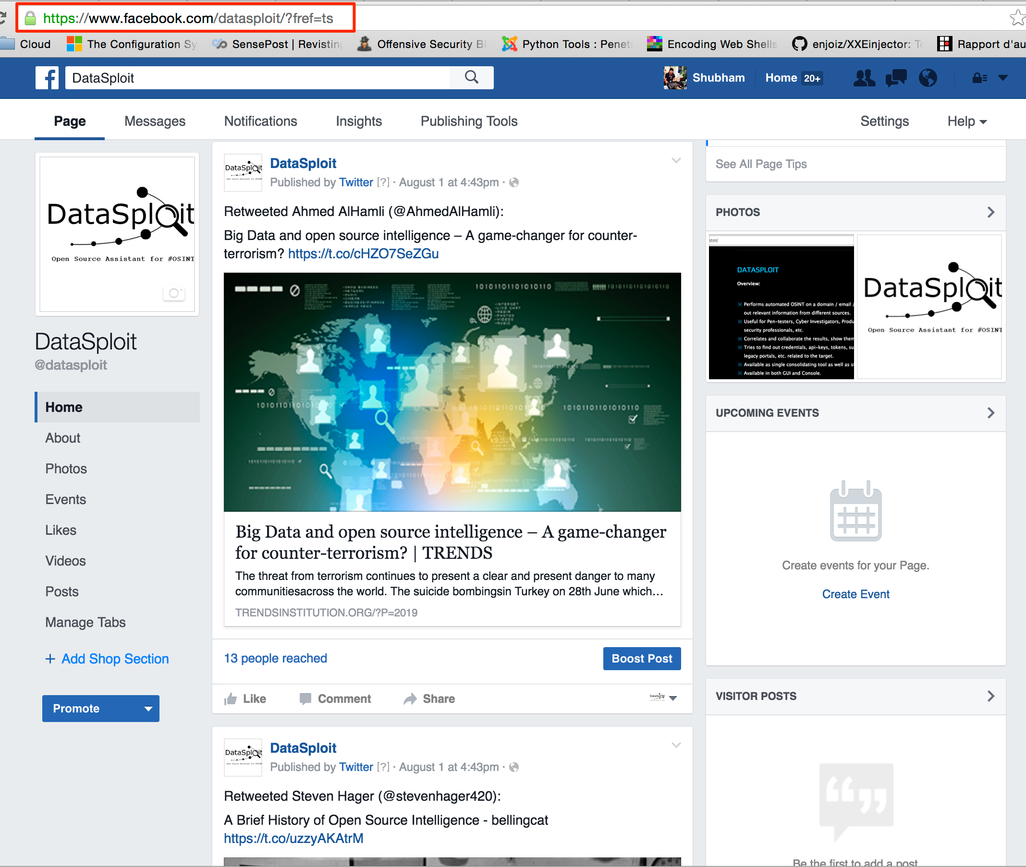
Facebook: /datasploit https://www.facebook.com/datasploit/

Slide 11
Roadmap
Reverse image search
Intelligence on co-relating and validating a profile
Porting all modules to web UI.
Use graphical and visualization templates on UI.
Modules on Phone Number / IP Address / facebook api / git info extract / etc.
Design pluggable APIs structure.
Alerting based on a periodic regular OSINT scan.
Harvest file > Extract metadata > Map vulnerabilities.
OSINT Tutorials.

Slide 12
How to Contribute
Test the tool (we have very bad dev skills, so you know ;))
Write a module. Or Suggest a module. (we love feedbacks).
Use / Promote / Write about the tool.
Write OSINT blogs / tool walkthrough(s) / etc.
Report issues at https://github.com/upgoingstar/datasploit/issues
Send message via twitter to @datasploit

Slide 13
Contributors.
Shubham Mittal (@upgoingstar)
Nutan Kumar Panda (@nutankumarpanda)
Susdhanshu (@sudhanshu_c)
Kunal (@KunalAggarwal92)

Slide 14
Thanks
View on GitHub Download .zip Download .tar.gz
Follow @datasploit for OSINT news and latest updates.

